Slide 1

(Un)Bias on Credit Risk Prediction
May 30th, 2020

Slide 2

Celio Rodrigues de Oliveira is a graduate student at the University of Toronto at the Master of Information Human-Centred Data Science with a collaborative Specialization in Knowledge Media Design.
Currently working for the National Research Council Canada, Construction Department at the Climate Resilient Buildings project.

Slide 3

Objective
The purpose of this study is:
a) Stress the importance of Data Scientists when dealing with sensitive information such as the Credit Default Risk Prediction;
b) Provide a reasonable explanation based on socioeconomic variables, historical relationship, and financial health analysis;
c) Compare human analysis versus IBM automated processes through AI Fairness 360 platform.

Slide 4

Technique
We are consenting to transform the whole data set into continuous variables.
This will allow us to treat the problem as a supervised classification.
Thus, it is not considered outlier detection, clustering analysis, dimensionality reduction techniques such as Principal Component Analysis, Pearson correlation, etc.
Once the data is preprocessed, we expose it to multiple machine learning algorithms from Random Forest to Neural Networks aiming to use the better classification score.
Notes:
Aiming to optimize human processes, we are taking advantage of Machine Learning techniques running multiple testing scenarios to predict events through statistics calculations working on the prevention of unwelcome trends.

Slide 5

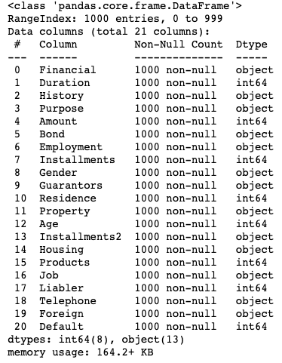
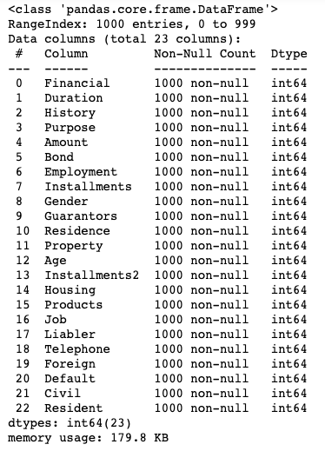
Data Engineering
In a quick analysis, we can see the new dataset from categorical to continuous variables.
Two new columns from the previous Gender and Job classification
Notes:
StandardScaler therefore cannot guarantee balanced feature scales in the presence of outliers.
MinMaxScaler rescales the data set such that all feature values are in the range [0, 1] as shown in the right panel below. However, this scaling compress all inliers in the narrow range [0, 0.005] for the transformed number of households.

Slide 6
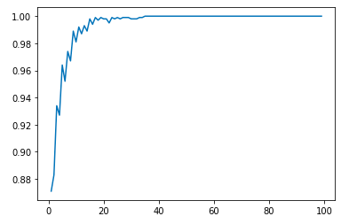
Purity and Entropy levels
It is measured the entropy and the information gain criteria to define the optimal number of splits in a decision tree grouping observations with similar characteristics.
The purity level was reached after split of 38 terminal nodes.

Slide 7

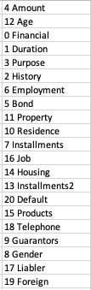
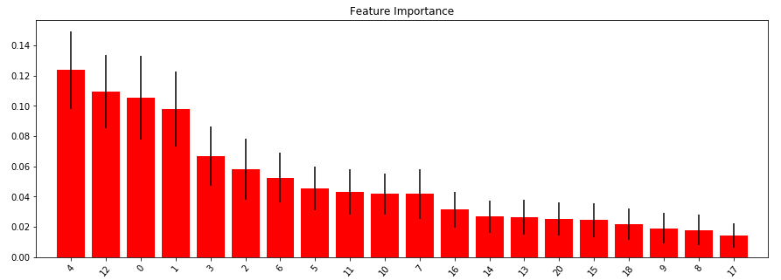
Feature Importance
For this dataset, features were classified according to information gain criteria in the following order:

Slide 8
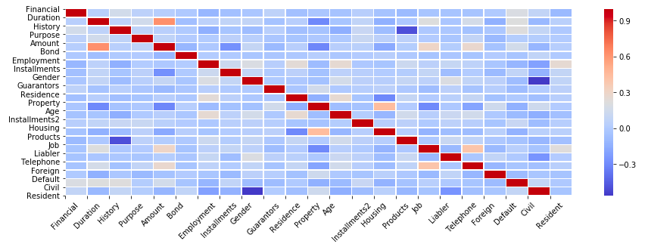
Feature Correlation - Heatmap

Slide 9
Feature Correlation
This analysis brings some expected correlated criteria and intriguing others:
1. Positive correlation between Credit Amount and the Duration of an existing checking account,
2. Medium Positive correlation between Property, Residence, and Housing as clients who own their houses have a property and do live there for a few years, as well as Job and Foreign as this is the most reasonable explanation for having a foreigner in the country (if not for study),
3. Weak Positive correlation between having a Job and a registered Telephone number,
4. Negative correlation between Civil status, Gender and Permanent Resident status; and surprisingly between Credit History and the number of products with the financial institution,
5. Weak Negative correlation between the Duration of the relationship, the Amount of money being administrated by the institution, and owning a Property.

Slide 10

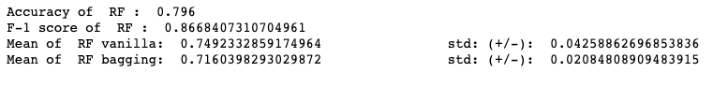
Bagging Methods
The best grouped model is the Random Forest using the unbiased* dataset that performed 79.6% average and a F-1 score of 86.7%. This represents a better performance in 3% compared to the bias dataset.
Remembering that F-1 score is based on correctly classified True Positive values. Therefore, credit analysis algorithms have the intention to prevent credit concession to high risk clients, this is the metric that matters most for this study.
*Unbiased because it is not considered variables like Gender and Race.

Slide 11
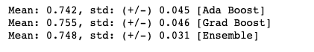
Boosting and Neural Networks
The best boosting model is the Gradient Boosting also applied on the unbiased dataset, and has a 75.5% performance with a standard deviation of 0.046.
NN performed poorly with an overall accuracy of 70%, using a combination of TanH, Softplus and ReLu as activation functions on each neural layer and Adam as the optimizer.

Slide 12

Benchmark
Both fairness metrics and mitigation algorithms can be performed at various stages of the machine learning pipeline.
It is recommended to check for bias as often as possible, using as many metrics are relevant for the application domain. We also recommend incorporating bias detection in an automated continuous integration pipeline to ensure bias awareness as a software project evolves.
Next slide shows the IBM Fairness 360 results.

Slide 13
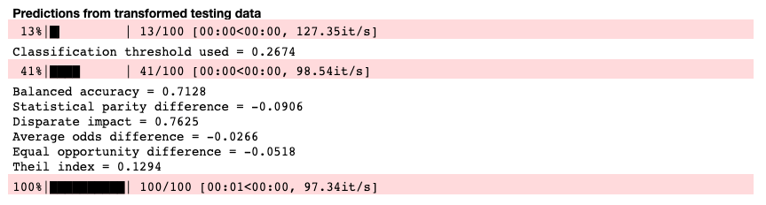
Benchmark – IBM Auto Fairness 360
The automated solution from IBM performed some data transformation and weigh imputation.
However, this model performance is 71.3% outperformed by our Bagging model Random Forest with 79.6% and IBM does not compute F1-score.

Slide 14
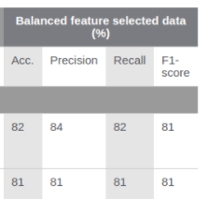
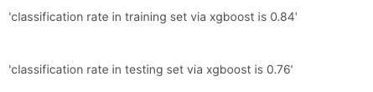
Benchmark – Classification (AIF360)
There are other classification algorithms using the German dataset in the literature. I relate two of those below:
Model 2.
Model 1.
It is possible to reproduce the model 2 outcome, but it will require more working hours to fine tune the dataset extracting the best representation of it and applying hyperparameter tuning techniques.

Slide 15
To be continued …
Celio Oliveira, Data Scientist
Oliveira.celior@gmail.com
+1 437.777.9306

